Slide 1

Case Study 3
RIGnet team:
Robert Asvicas
Ibrahim Taie Ahmed Soliman
Gabriel Rafael
The Netherlands 2020

Slide 2
About us
R
I
G
Robert
Ibrahim
Gabriel
A 19-year-old guy, grew up in Lithuania. Whole life was playing video-games, but at one point, realized that wants to do something beyond that. That’s how his interested in IT started.
A 29 years old geek who enjoys studying IT topics. With a previous IT study he decided to join school again to overtake the cyber security specialty.
A 26 years old ex certified electrician that loves making DIY projects and be able to build or modify something into prototype models and joined courses.

Slide 3

Problem
Client has electronic items in the warehouse (video-cards, raspberry pi, used PCs, etc.)
Client wants to monitor his warehouse
Client wants to sell those items
Client wants to have scalable environment

Slide 4




Solution
Website
Website to view products
Application
Application to maintain posts and receive sensor information
Sensors
Sensors on Raspberry Pi that receive information about light, humidity and temperature
Environment
Environment - secure and trustworthy closed environment

Slide 5
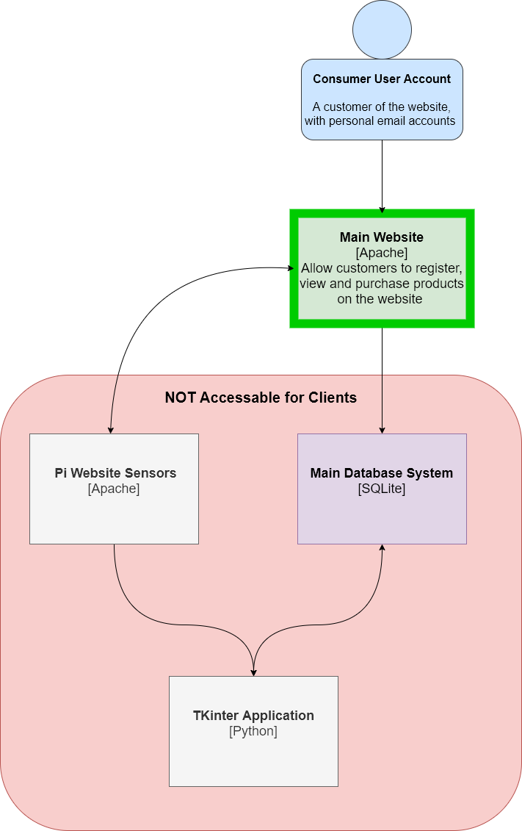
Idea of the project

Slide 6


Environment
Hyper-V
Our whole environment are Virtual Machines:
CentOS – Hosting Webserver
Ubuntu – RADIUS
Windows Server – Microsoft SQL Server/Tkinter application
NagiosXI – Monitoring tool
Firewall - pfSense

Slide 7
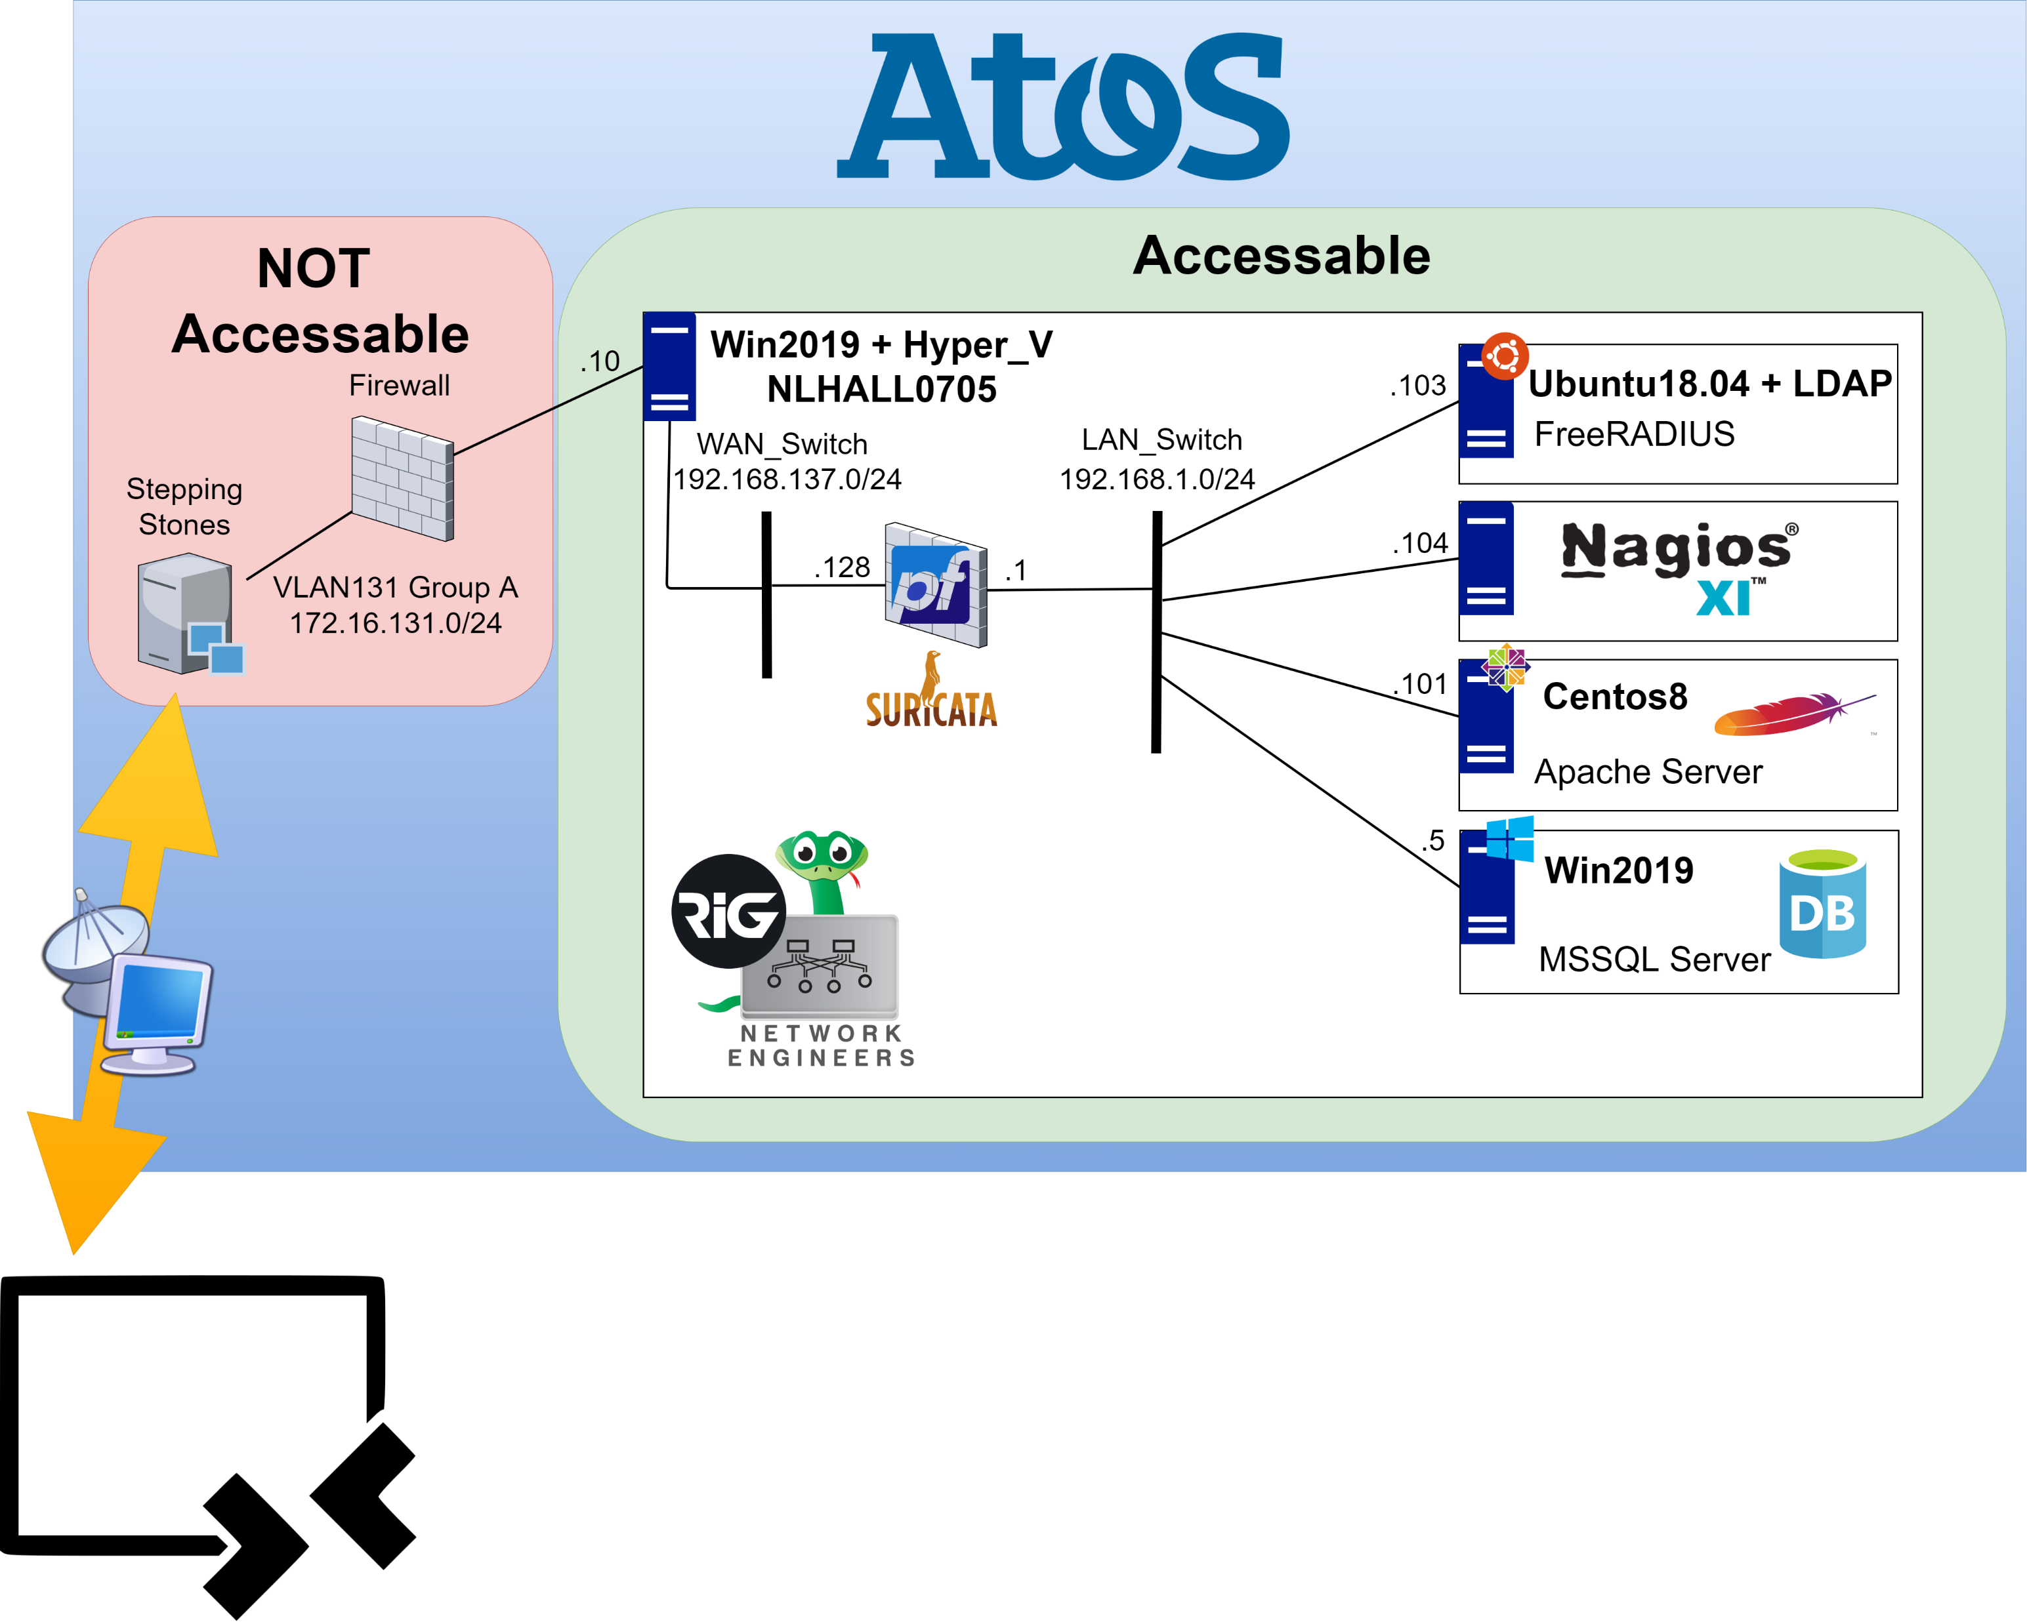

Slide 8


Website
Flask/Apache website
Runs on Centos
Connected to MS SQL database
Register new users
Login with existing users

Slide 9

Sensors
Raspberry-Pi 4
We are using 2 sensors to get 3 types of info:
Temperature (dht11)
Humidity (dht11)
Light (dht11)

Slide 10

Application
Python, Tkinter
For developing app GUI Tkinter was used
Functionality:
Add new post
Check Sensor Information
Not implemented:
Inventory

Slide 11

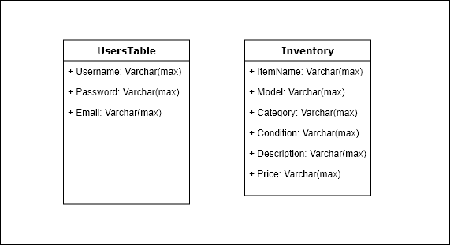
Microsoft SQL Server

Slide 12
Encountered challenges, issues and problems
Project did not go as it was planned…
Miscommunication
Unstable environment
Improper time assessment
Inability to catch up with the courses

Slide 13
DEMO

Slide 14
Thank you for your attention

